Slide 1
Water Turbidity Measurement-Algorithm
Nitay ozer
Itay mal
supervisor adi vainiger

Slide 2
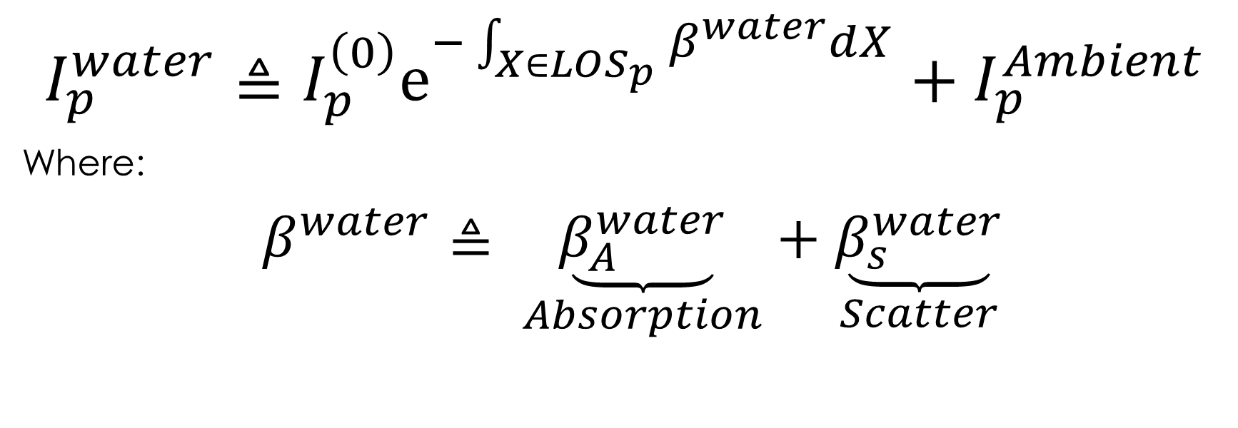
RTE
$$I_{p}^{water}≜I_{p}^{\left(0\right)}e^{−\int_{X∈LOS_{p}}{β^{water}dX}}+I_{p}^{Ambient}$$
Where:
$β^{water}≜$ $\underset{Absorption}{\underbrace{β_{A}^{water}}}+\underset{Scatter}{\underbrace{β_{s}^{water}}}$

Slide 3
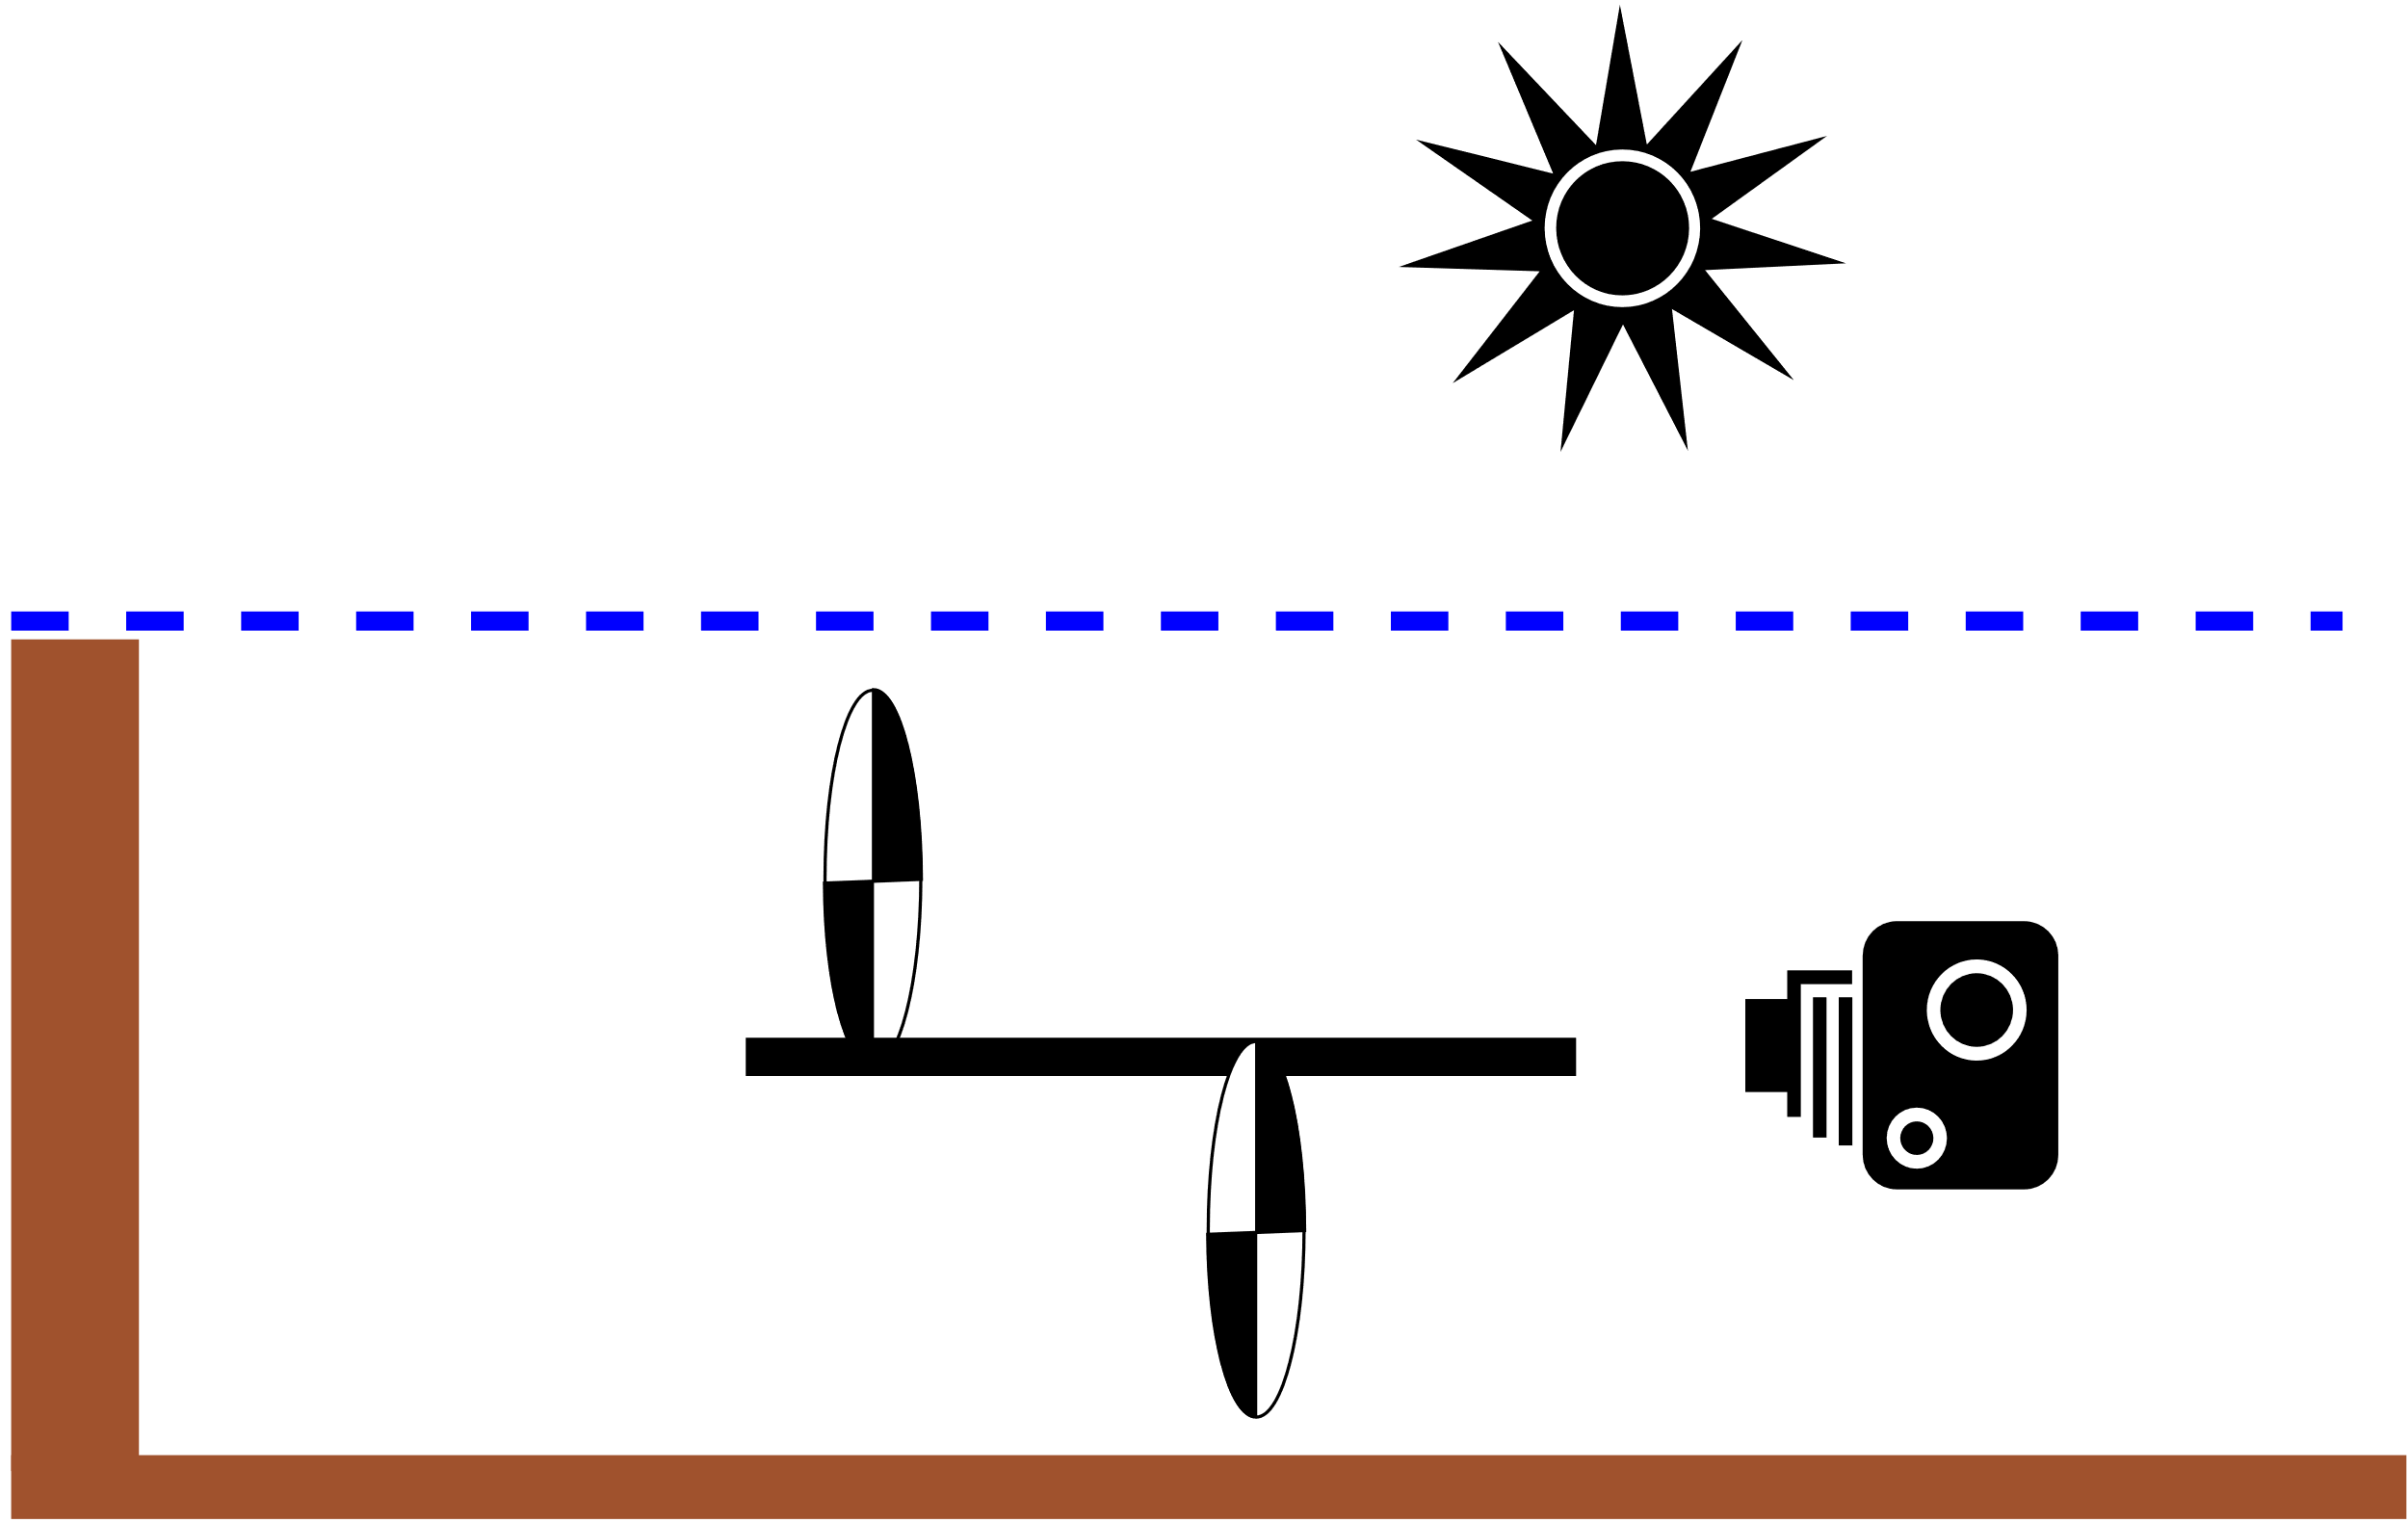

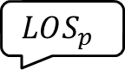
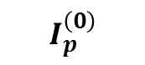
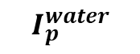
Our Approach
Natural light
$$β^{water}$$
$$I_{p}^{\left(0\right)}$$
$$LOS_{p}$$
$$I_{p}^{water}$$

Slide 4
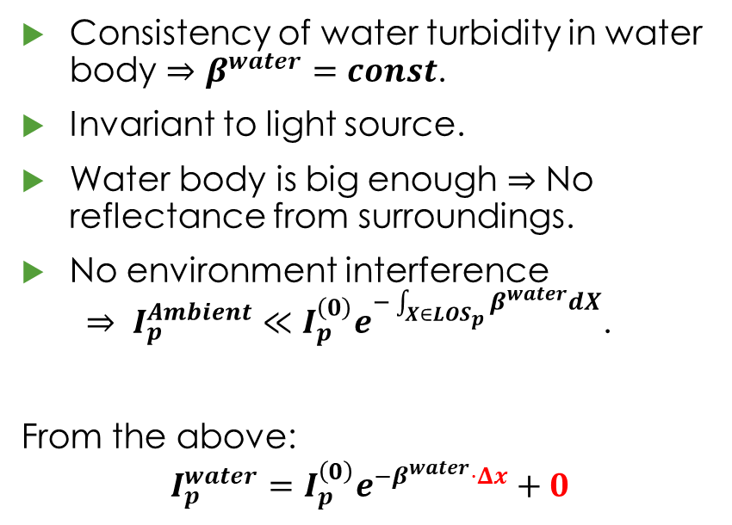
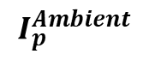
Basic Assumptions
Consistency of water turbidity in water body $⇒β^{water}=const$.
Invariant to light source.
Water body is big enough $⇒$ No reflectance from surroundings.
No environment interference $⇒ I_{p}^{Ambient}≪I_{p}^{\left(0\right)}e^{−\int_{X∈LOS_{p}}{β^{water}dX}}$.
From the above:
$$I_{p}^{water}=I_{p}^{\left(0\right)}e^{−β^{water}⋅Δx}+0$$
$$I_{p}^{Ambient}$$

Slide 5
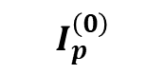

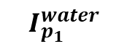
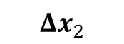
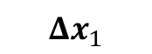
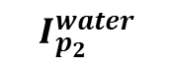
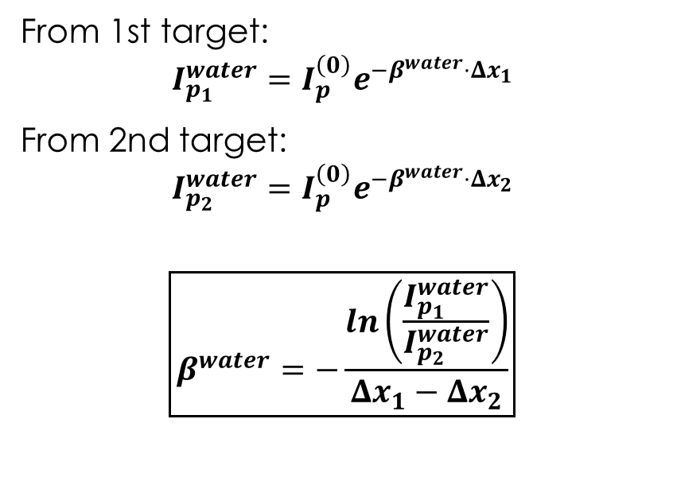
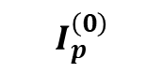
Calculating $β^{water}$ with 2 Targets
From 1st target:
$$I_{p_{1}}^{water}=I_{p}^{\left(0\right)}e^{−β^{water}⋅Δx_{1}}$$
From 2nd target:
$$I_{p_{2}}^{water}=I_{p}^{\left(0\right)}e^{−β^{water}⋅Δx_{2}}$$
$$\boxed{β^{water}=−\frac{ln\left(\frac{I_{p_{1}}^{water}}{I_{p_{2}}^{water}}\right)}{Δx_{1}−Δx_{2}}}$$
$$I_{p}^{\left(0\right)}$$
$$Δx_{1}$$
$$I_{p_{1}}^{water}$$
$$I_{p}^{\left(0\right)}$$
$$I_{p_{2}}^{water}$$
$$Δx_{2}$$

Slide 6
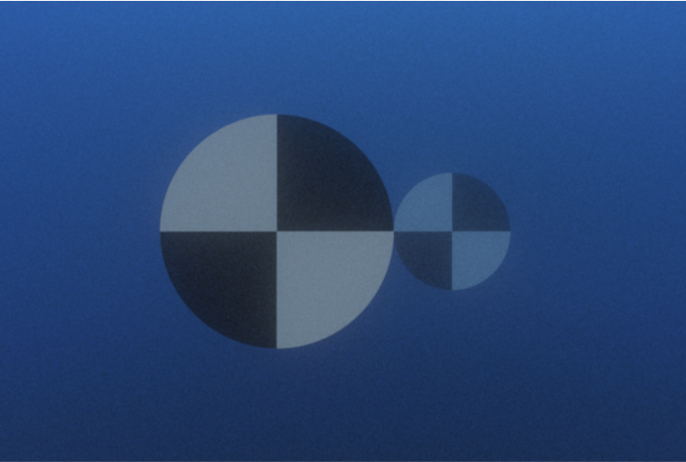
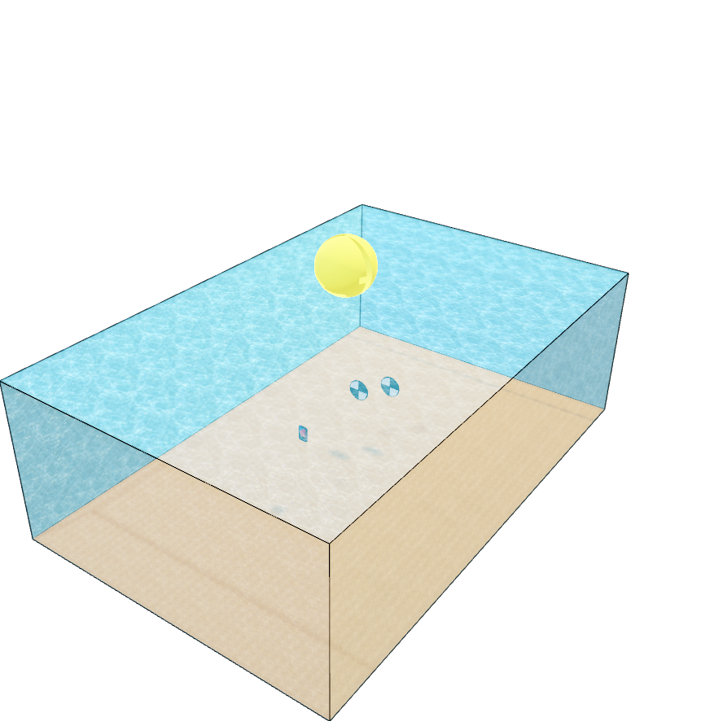
Measurement Setup

Slide 7
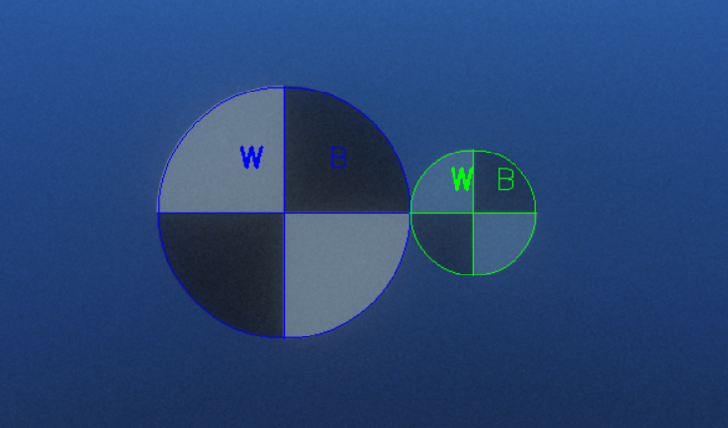
Step I – Detecting the Targets

Slide 8
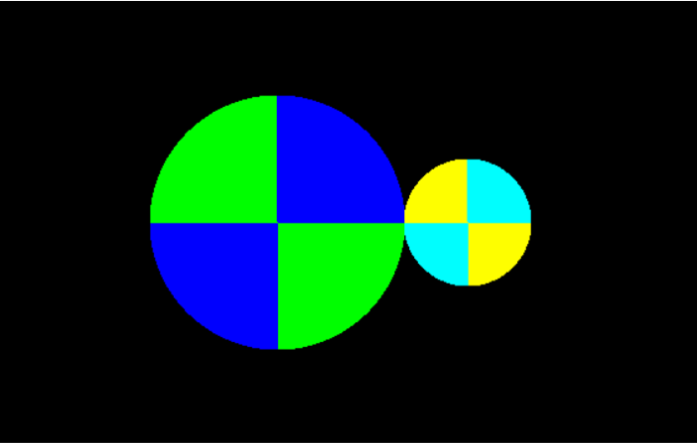
Step II – Averaging the Quarters

Slide 9
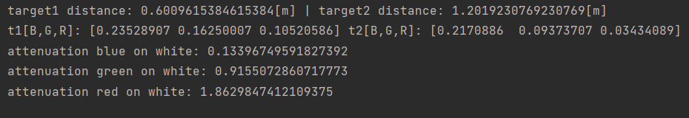


Step III – Calculating
Real Values:
$Δx_{1}$= 0.6
$Δx_{2}$= 1.2
$β_{s}^{water}(r,g,b)$= (0.64, 0.64, 0.64)
$β_{A}^{water}(r,g,b)$ = (0.5, 0.2, 0)
$β^{water}(r,g,b)$ = (1.14, 0.84, 0.64)
Estimated Values:
$Δx_{1}$= 0.6009
$Δx_{2}$= 1.2019
$β_{s}^{water}(r,g,b)$= ???
$β_{A}^{water}(r,g,b)$ = ???
$β^{water}(r,g,b)$ = (1.86, 0.91, 0.13)

Slide 10
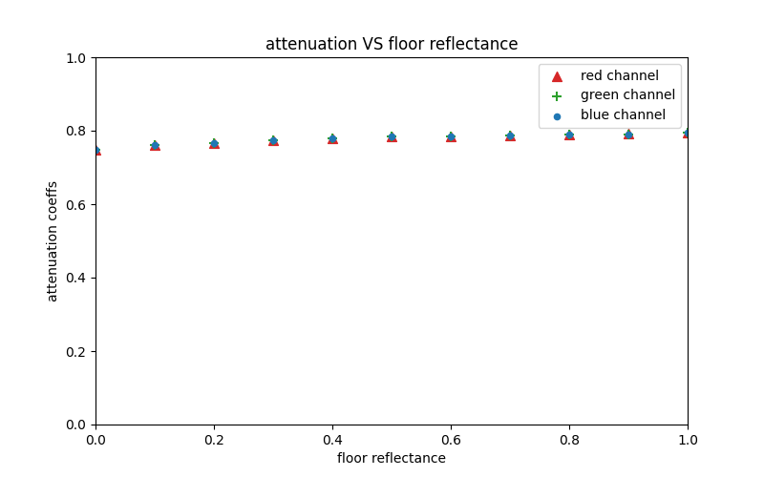
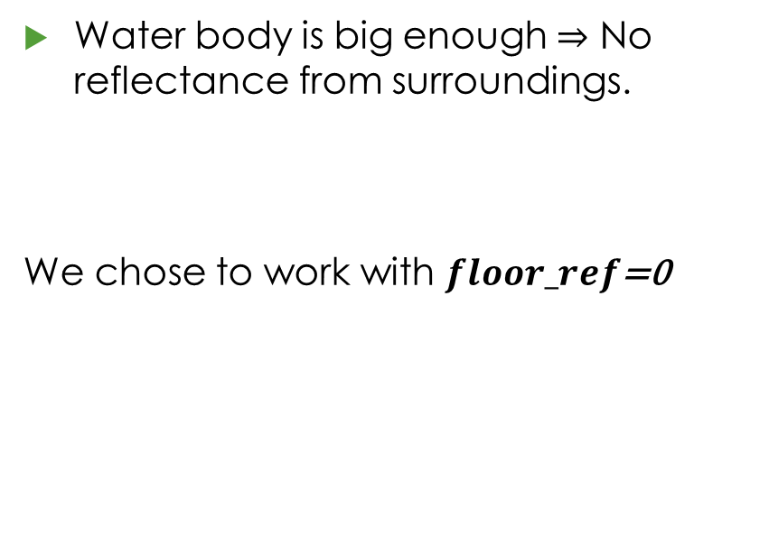
Validating Assumptions
Water body is big enough $⇒$ No reflectance from surroundings.
We chose to work with $floor_ref\text{=}\text{0}$

Slide 11
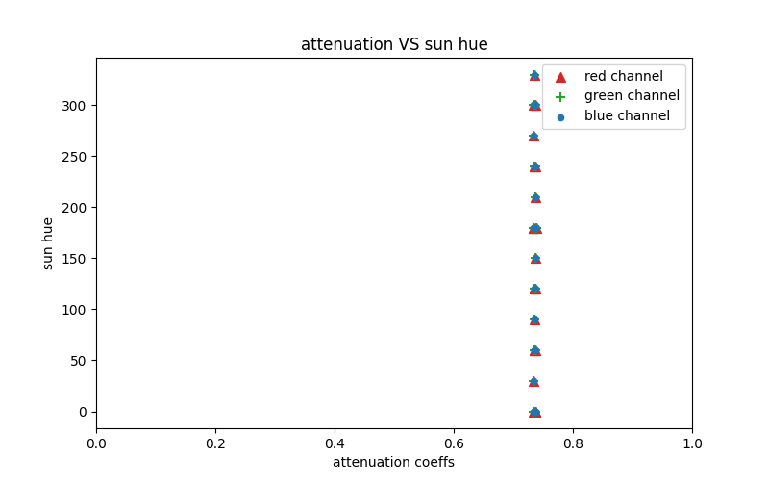
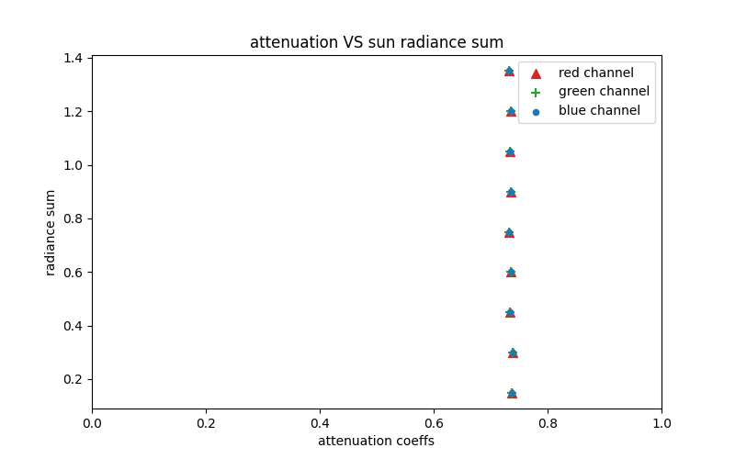
Validating Assumptions
Invariant to light source.

Slide 12
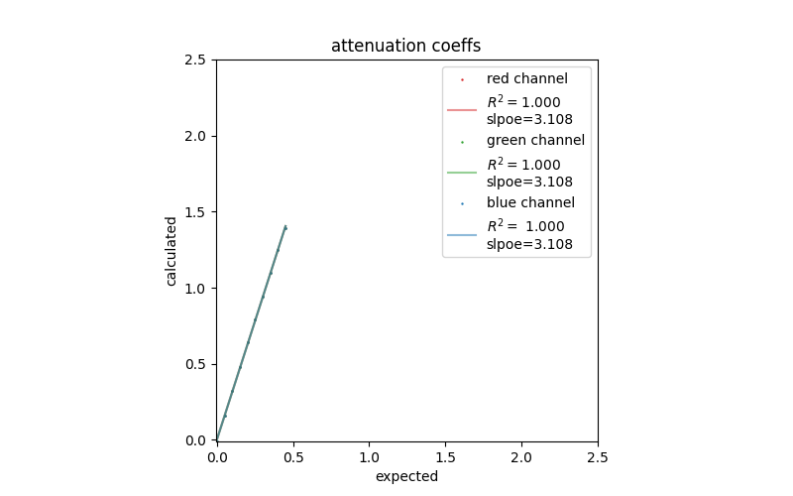
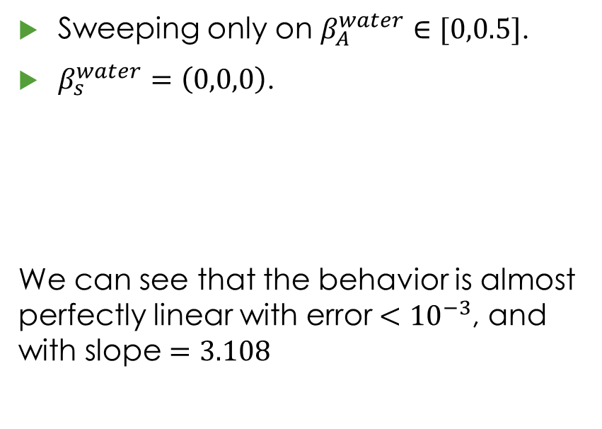
Checking Absorption
Sweeping only on $β_{A}^{water}∈[0,0.5]$.
$β_{s}^{water}=\left(0,0,0\right)$.
We can see that the behavior is almost perfectly linear with error $<{10}^{−3}$, and with slope $=3.108$

Slide 13
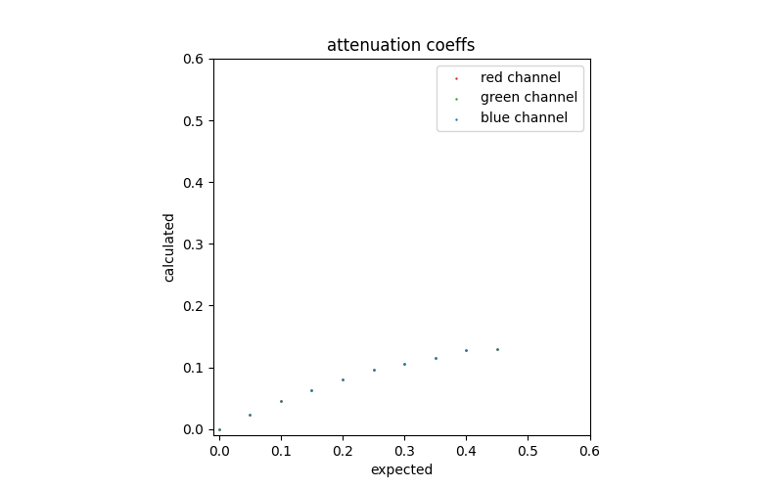
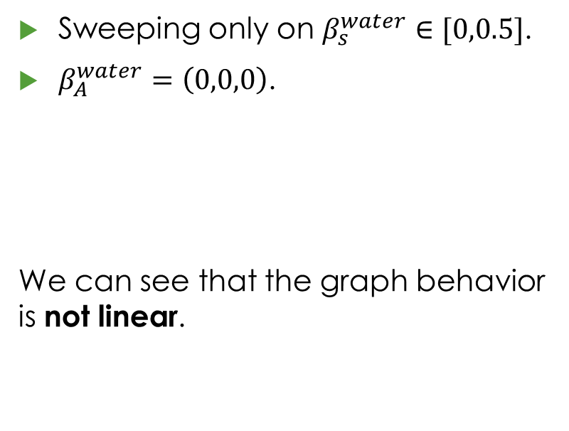
Checking scatter
Sweeping only on $β_{s}^{water}∈[0,0.5]$.
$β_{A}^{water}=\left(0,0,0\right)$.
We can see that the graph behavior is not linear.

Slide 14
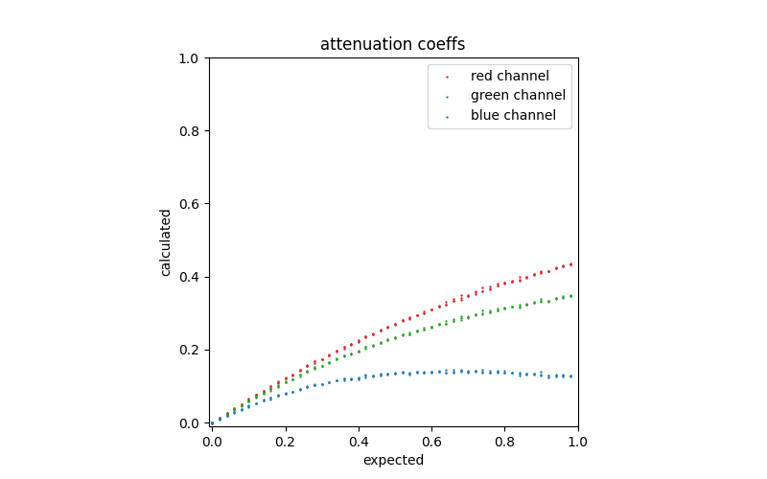
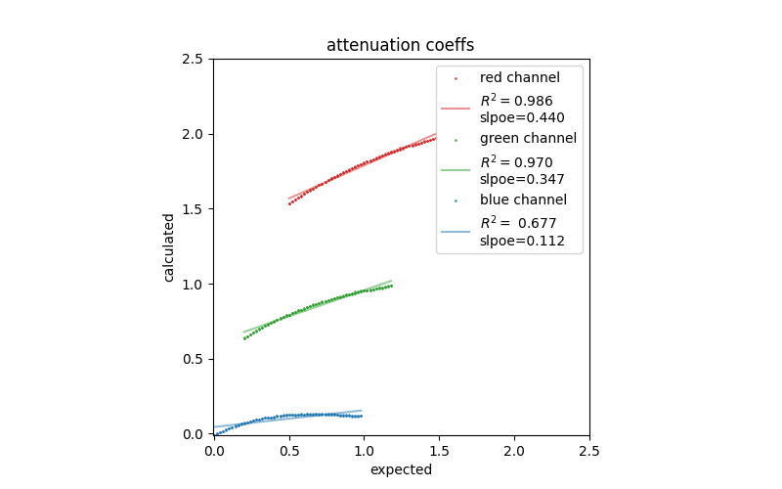
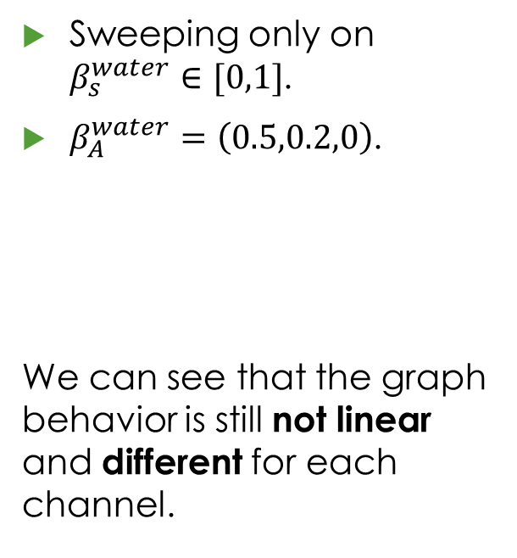
Checking scatter with absorption
Sweeping only on $β_{s}^{water}∈[0,1]$.
$β_{A}^{water}=\left(0.5,0.2,0\right)$.
We can see that the graph behavior is still not linear and different for each channel.

